Slide 1
Bat tooth extraction

Slide 2
[1] "R0=0.81852030844612"
species adult_fecundity juv_survival adult_survival pop_growth_rate llik AIC convergence
1 Eidolon dupreanum 0.48 0.68 0.6015557 0.82 -1.998271 5.996541 0
Warning message:
[1] "R0=0.504852173483315"
species adult_fecundity juv_survival adult_survival pop_growth_rate llik AIC convergence
1 Pteropus rufus 0.48 0.68 0.3534744 0.5 -4.022594 10.04519 0
2013-2014
[1] "R0=0.878071300748806"
species adult_fecundity juv_survival adult_survival pop_growth_rate llik AIC convergence
1 Eidolon dupreanum 0.48 0.2428531 0.8956003 0.88 -16.27586 34.55172 0
[1] "R0=0.434881506225279"
species adult_fecundity juv_survival adult_survival pop_growth_rate llik AIC convergence
1 Pteropus rufus 0.48 0.68 0.2494507 0.43 -5.575897 13.15179 0
2015-2016
[1] "R0=0.99451848311383"
species adult_fecundity juv_survival adult_survival pop_growth_rate llik AIC convergence
1 Eidolon dupreanum 0.48 0.3177251 0.8676729 0.99 -8.944432 19.88886 0
[1] "R0=0.484275419929023"
species adult_fecundity juv_survival adult_survival pop_growth_rate llik AIC convergence
1 Pteropus rufus 0.48 0.68 0.3260035 0.48 -4.105986 10.21197 0
2017-2018

Slide 3
[1] "R0=1.26388001325165"
species adult_fecundity juv_survival adult_survival pop_growth_rate llik AIC convergence
1 Eidolon dupreanum 0.48 0.6201551 0.7706093 1.26 -17.91672 37.83343 0
"R0=0.458501089784529"
species adult_fecundity juv_survival adult_survival pop_growth_rate llik AIC convergence
1 Pteropus rufus 0.48 0.68 0.2881151 0.46 -9.441636 20.88327 0
2019-2020

Slide 4
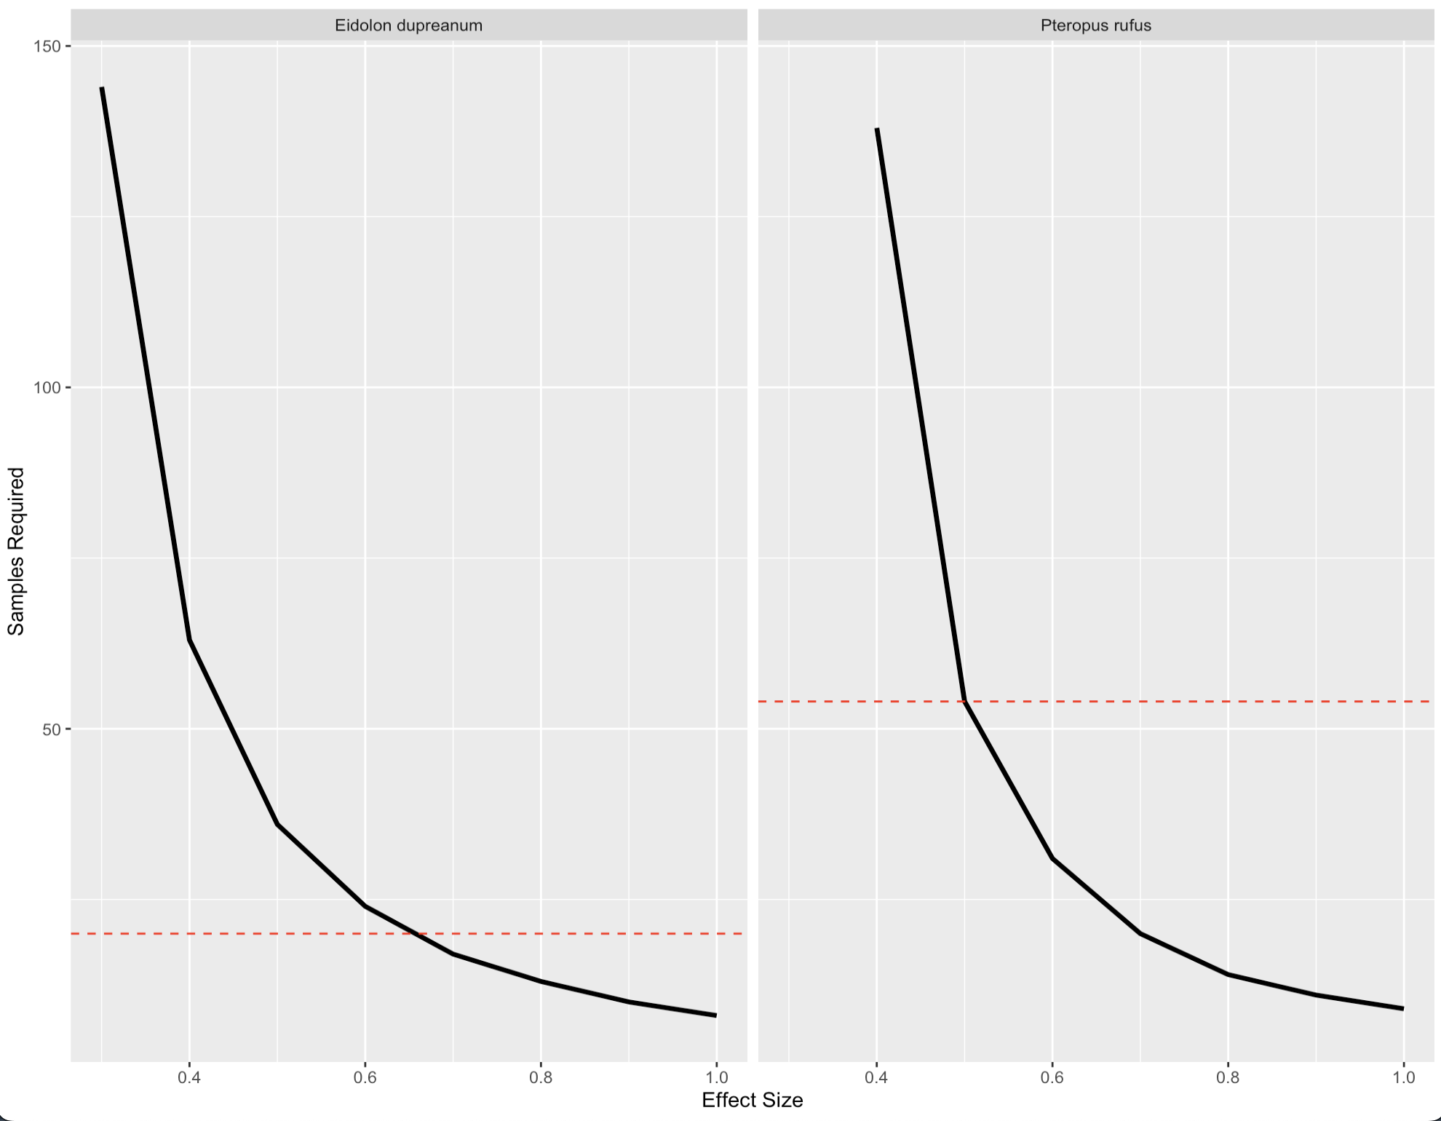
small
moderate
large
small
moderate
large

Slide 5
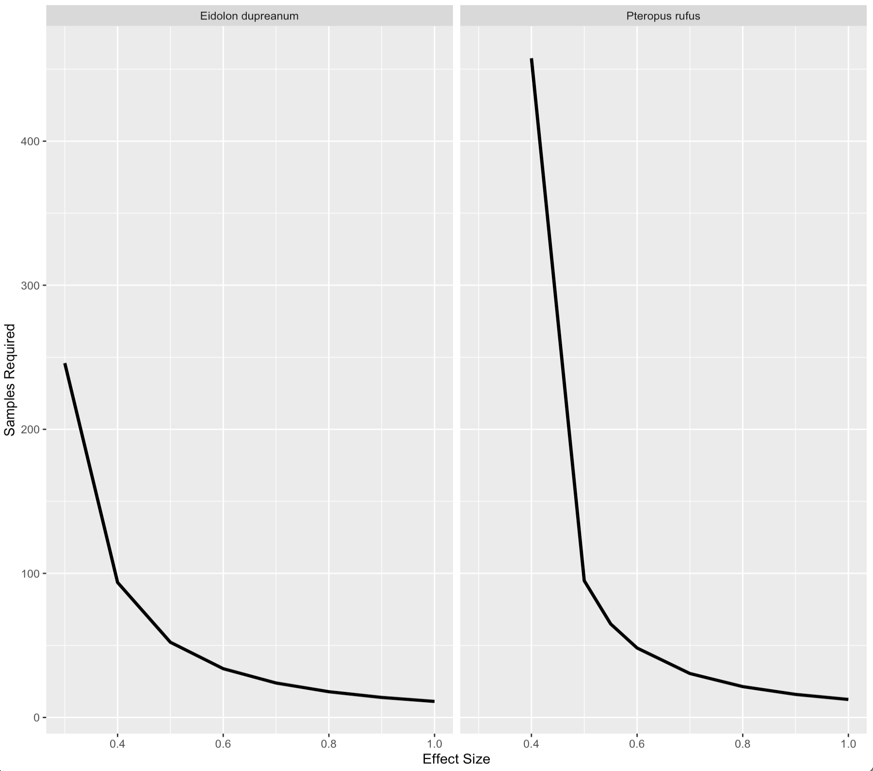
A
B
Effect Size (ES) | Interpretation
0.00 < ES < 0.20 | Negligible
0.20 < ES < 0.50 | Small
0.50 < ES < 0.80 | Moderate
0.80 < ES < 1.30 | Large

